Slide 1
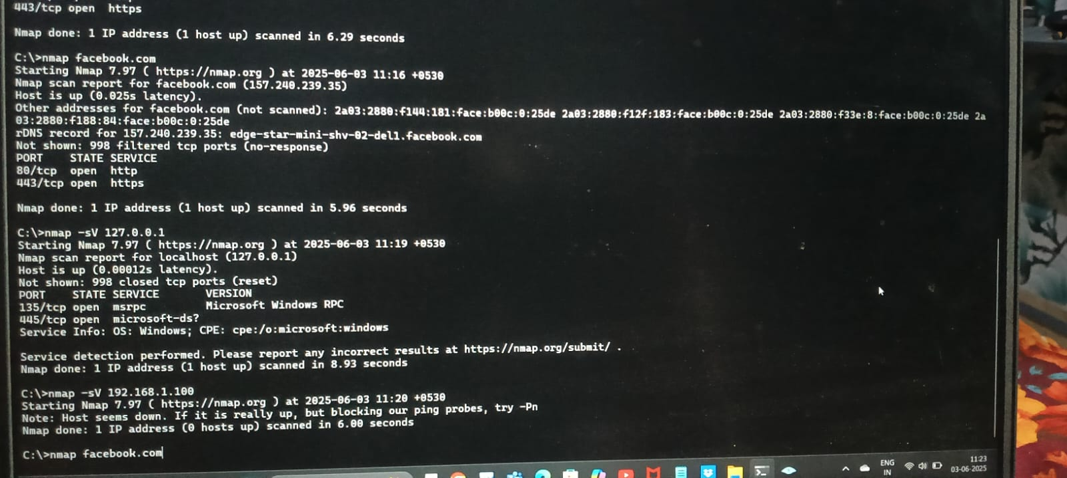
Basic Network Scanning With Nmap

Slide 2
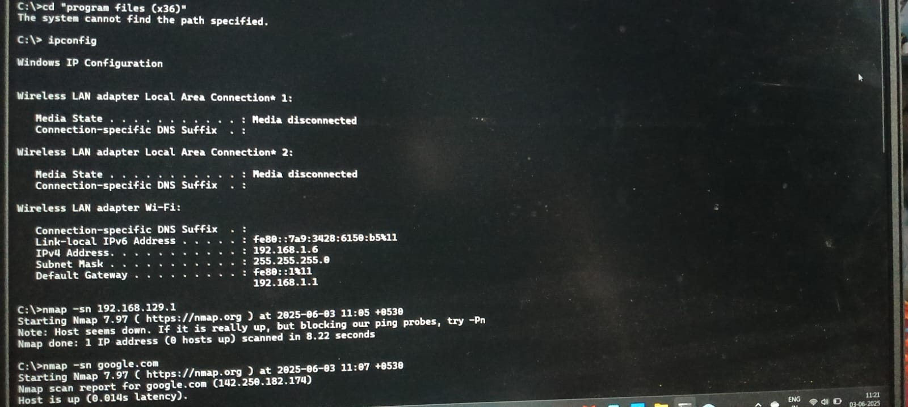

Slide 3
